Slide 1
Introduction to Blockchain &
Ethereum

Slide 2
How does a normal payment system work?
Account | A | B | C | D
Initial | 75 | 60 | 10 | 100
Transfer | -50 | +50
Transfer |  | +15 | +15
Transfer | -25 |  |  | +25
Transfer |  | -40 | +40
Transfer |  |  | +200 | -200
Transfer | +50 | -50
Notes:
In essence, all bitcoin is is really a distributed ledger composed of thousands of nodes. In a centralized system that would look something like this:
For a centralized server, checking if someone is trying to spend money they don’t have or to double spend money by using the same money for two transactions it’s fairly easy as they can see the order of transactions and verify account balances.

Slide 3
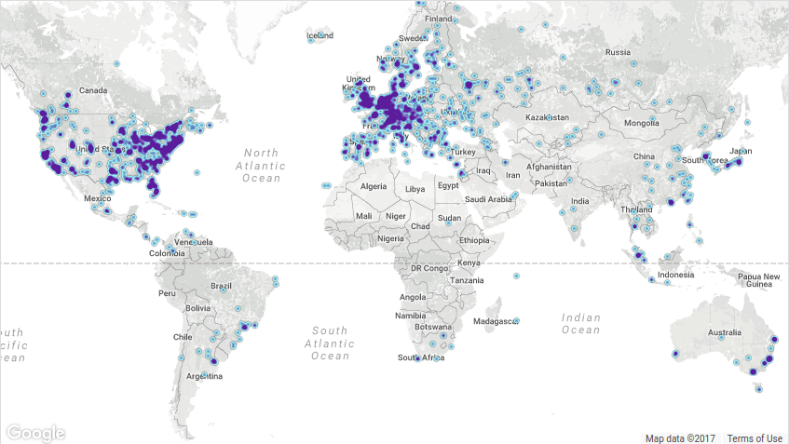
Distributed Ledger
Notes:
For a centralized server, checking if someone is trying to spend money they don’t have or to double spend money by using the same money for two transactions it’s fairly easy as they can see the order of transactions and verify account balances.
In a system of thousands of nodes, how can you effectively timestamp all these transactions in order to be able to prevent double spending and other issue?.

Slide 4
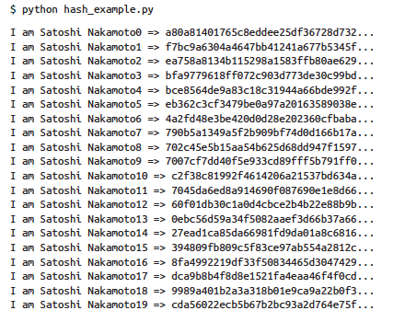
Hashing

Slide 5
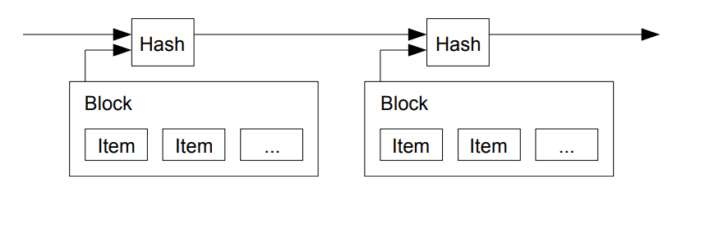
Blockchain
Notes:
The blockchain functions in many ways as a timestamp server. In each block, all the transactions are included and a hash is found meaning that if you change a single item it invalidates the hash. The next block has a hash of all the transactions but also includes a hash of the previous block. THat way, if an attacker attempts to change an old block, all the following blocks are invalidated and must be redone.

Slide 6
Distributed Ledger
Account | A | B | C | D
Initial | 75 | 60 | 10 | 100
Transfer | -50 | +50
Transfer |  | +15 | +15
Transfer | -25 |  |  | +25
Transfer |  | -40 | +40
Transfer |  |  | +100 | -100
Transfer | +50 | -50
Transfer | -30 |  |  | +30
Transfer | -20 | +20
Transfer |  | +65 | -65
Transfer |  |  | -50 | +50
Transfer | +20 | -20
Transfer |  | +30 | -30
Hash
Hash
Hash
Hash
Notes:
So as a ledger, bitcoin looks something like this: each block has a hash of the previous blocks as well as all the transactions. So when (point to later transaction) someone tries to send money at this point, it’s fairly easy for the network to check the current balance of that address by looking at all previous transactions.
As a solution to who creates these new blocks as well as how bitcoin is issued, a system called proof of work is used.

Slide 7
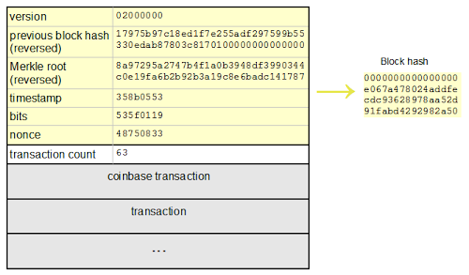
Block Sample

Slide 8
Proof-of-Work
Example
Example0
Example1
Example2
Example3
428e5c057fd2030c8858d04bd9ede89a
a98ede9db40d8588c0302df750c5e824
ef7719f731431f2985916e5e1d9cecd1
cffab4b95a6c8eaee20e11ed79bddda8
00f7c3d939685b664e1d8a8d99a952a4

Slide 9
Example of an Actual Block

Slide 10
PGP
Private Key: A secret key that you don’t share
Public Key: Key that you share with others

Slide 11
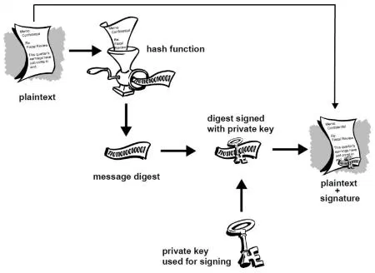
Digital Signatures

Slide 12
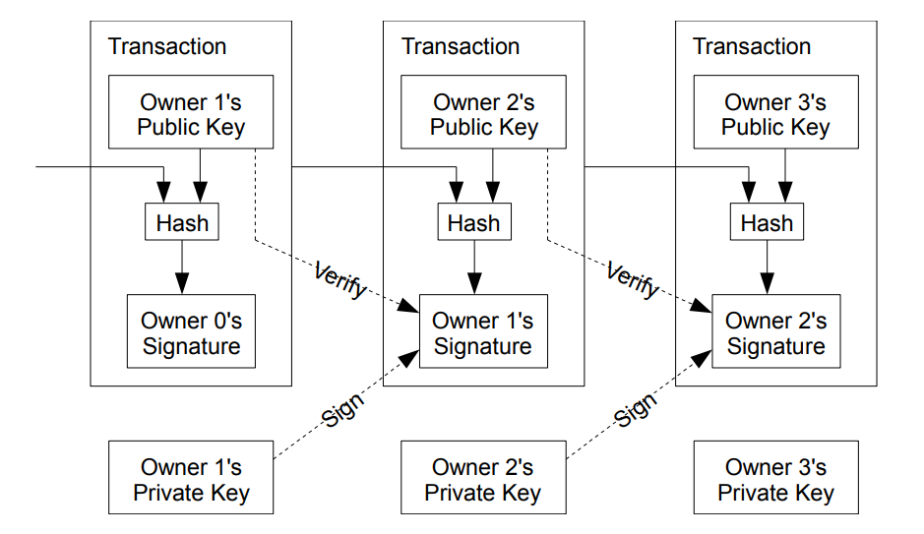
Transactions
https://chrispacia.wordpress.com/2013/09/07/bitcoin-cryptography-digital-signatures-explained/
Notes:
We define an electronic coin as a chain of digital signatures. Each owner transfers the coin to the next by digitally signing a hash of the previous transaction and the public key of the next owner and adding these to the end of the coin. A payee can verify the signatures to verify the chain of ownership.
An issue that you might run into is how do you prevent double spending? Be aware of all transactions. Mint can do this but in this case all the nodes need to do it.
This also requires some kind of timestamp to keep track of when transactions occured.

Slide 13
Steps for Running the Network
Users broadcast their transactions to the network who give these to miners.
Miners receive these transactions and include them in their next block and attempt to find a nonce.
When a miner succeeds in finding a proof-of-work, they broadcast their block to the network. Nodes on the network verify that all transactions are valid and then broadcast it to other nodes till all nodes accept the block.
Miners then repeat the process and use the previous block hash in their new block.
https://bitcoin.org/bitcoin.pdf

Slide 14
Ethereum
https://github.com/ethereum/wiki/wiki/White-Paper

Slide 15
Traditional Blockchains
-cryptocurrencies like bitcoin are only really meant for payment
-blockchains like namecoin can do other things but are still highly specialized

Slide 16
Ethereum
-Meant as a general usage platform upon which other applications can be built
-Ethereum Virtual Machine (EVM) is the core of the platform
-can deploy programs of arbitrary complexity to the EVM
http://ethdocs.org/en/latest/introduction/what-is-ethereum.html

Slide 17
Ethereum Virtual Machine (EVM)
-”World Computer”
-code deployed to the EVM is run by every node on the network
-allows for:
-extreme fault-tolerance
-zero down-time
-censorship-resistant and immutable

Slide 18
Smart Contracts
-fully-autonomous code that cannot be retracted once deployed
-can do things such as reads, writes, computations, send messages to other contracts, store data

Slide 19
Gas
-as all smart contracts deployed to the network are also pushed to every node, there must be some limiting mechanism
-’Gas’ is the fee for both smart contracts and transfers
-each operation done by a smart contract has a fee in gas
-each unit of gas must be paid in ether based on a gas/Ether price conversion
-usage as gas is the primary purpose of ethereum
https://blog.zeppelin.solutions/the-hitchhikers-guide-to-smart-contracts-in-ethereum-848f08001f05

Slide 20
Examples of Basic Smart Contracts
-Proof-of-Existence
-Creation of a token
-Secure multi-party fund
-Voting mechanisms
Notes:
z

Slide 21
contract MyToken { /* This creates an array with all balances */ mapping (address => uint256) public balanceOf; /* Initializes contract with initial supply tokens to the creator of the contract */ function MyToken( uint256 initialSupply ) { balanceOf[msg.sender] = initialSupply; // Give the creator all initial tokens } /* Send coins */ function transfer(address _to, uint256 _value) { require(balanceOf[msg.sender] >= _value); // Check if the sender has enough require(balanceOf[_to] + _value >= balanceOf[_to]); // Check for overflows balanceOf[msg.sender] -= _value; // Subtract from the sender balanceOf[_to] += _value; // Add the same to the recipient } }

Slide 22
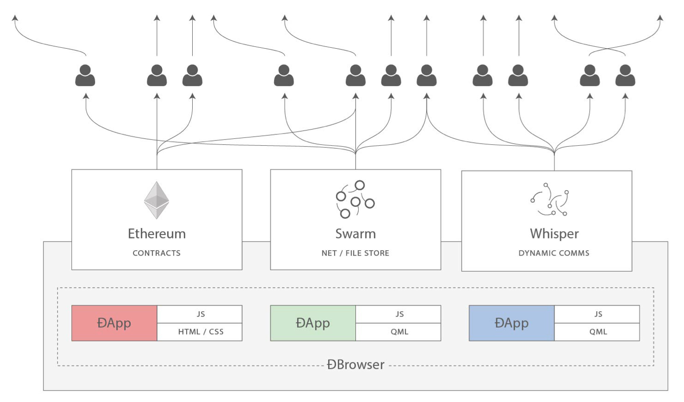
DApps
https://blog.ethereum.org/2014/08/18/building-decentralized-web/

Slide 23
Swarm
-meant for decentralized storage
-p2p, ddos-resistant, zero-downtime, fault-tolerant, and censorship-resistant
-smart-contracts have high gas costs for storing large amounts of information
-swarm is meant to work alongside smart-contracts for storing data as well as for hosting
-beta version available now, currently under active development
-built in incentive system for users to participate
-IPFS
http://swarm-guide.readthedocs.io/en/latest/introduction.html

Slide 24
Whisper
-meant to allow for communication between DApps/users
-still in early alpha
https://github.com/ethereum/wiki/wiki/Whisper

Slide 25
Examples of DApps
-provably fair gambling service/lottery
-DAO
-decentralized social network
-reddit alternative with currency as a motive
-decentralized cryptocurrency exchange
-DAPPS

Slide 26
Issues
-code can’t be changed easily after it’s deployed
-network congestion (ICOs)
-Disagreement on hard fork

Slide 27
Getting Access to Cryptocurrencies

Slide 28
Buying Cryptocurrencies
-in Korea, a couple options for online exchange are:
-Bithumb
-Korbit
-Coinone

Slide 29
Buying Cryptocurrencies
-localbitcoins.com
-http://bitcoincenterkorea.org/
-Buying from a friend

Slide 30
Converting Cryptocurrencies
-shapeshift.io

Slide 31
Crypto Wallets
-If you have the storage space and are planning to do dev work, mist is your best option for ethereum and ethereum tokens
-Otherwise, myetherwallet is a secure and trustable option
-For Bitcoin, electrum is the best open-source light-wallet
-If you’re willing to take a bit of a risk, Exodus.io is a fantastic wallet with support for many currencies
-Most secure option (second to an offline computer/paper wallet) is a hardware wallet like the Ledger Nano S or Trezor

Slide 32
Investment Opportunities
-ICOs
-Trading
-Holding

Slide 33
News Sources
-DApp Daily (eth related news)
-Ethereum Subreddit
-Cointelegraph (general cryptocurrency news)
-Coindesk (primarily bitcoin news)
-Brave New Coin (general cryptocurrency news)
-Bitcoin Talk (most popular bitcoin forums)
-Hodl News (blockchain news aggregator)

